Slide 1
TDS Data Services
John Caron
Unidata/UCAR
July 2009

Slide 2
Data Services
Bulk File Transfer
  HTTP Server (any file)
Remote access, subsetting CDM files
  OPeNDAP (any* CDM file)
  Web Coverage Service (grids)
  Web Map Service (grids)
  NetCDF Subset Service (grids)

Slide 3
???
Who are your clients?
  Browsers (humans clicking on HTML)
  Programs
What remote data access protocol(s) do they speak?
  What can I ask for?
What file formats (mime types) can they understand?
  What do I get back?

Slide 4
Subsetting vs File transfer
File Transfer
  Simple, pre-web
  Files not too large, know how to read them
  No translation errors
Subsetting
  Very large datasets
  Virtual files
  Can translate original file to standard format

Slide 5
TDS clients
Catalogs
  Browser (simple)
  IDV
  NetCDF-Java applications
OPeNDAP (lots, including IDL, MatLAB)
WCS (still minimal, but expect to grow)
  GDAL, CADCorp, George Mason
WMS (speak WMS, consume JPEGs)
  Browsers, Portals, ARC GIS, Google Earth, etc
NetCDF Subsetter
  HTML forms interface
  Web service (CUAHSI)
  ESRI ArcGIS (manual download of netcdf-CF)

Slide 6
NetCDF-Java library
Used as a component in other software (partial)
  Integrated Data Viewer, ToolsUI (Unidata)
  Panoply (NASA)
  ncBrowse (EPIC/NOAA)
  Java NEXRAD Viewer (NCDC/NOAA)
  MyWorld GIS (Northwestern)
  EDC for ArcGIS, ERRDAP (SFSC/NOAA)
  Live Access Server (PMEL/NOAA)
  ncWMS (Reading)
  Matlab plug-in (USGS)

Slide 7
Service elements
<?xml version="1.0" ?>
<catalog>
<service name=“dods" serviceType="OPENDAP" base="/thredds/dodsC/" />
<dataset name=“OzoneYear2004" serviceName=“dods" urlPath=“oz4.nc"/>
<dataset name=“OzoneYear2005" serviceName=“dods" urlPath=“oz5.nc"/>
</catalog>
<?xml version="1.0" ?>
<catalog>
<service name=“all" serviceType="Compound" base="" >
<service name=“dods" serviceType="OPENDAP" base="/thredds/dodsC/" />
<service name="wcsServer" serviceType="WCS" base="/thredds/wcs/" />
<service name="wmsServer" serviceType=“WMS" base="/thredds/wms/" />
</service>
<dataset name=“OzoneYear2004" serviceName=“all" urlPath=“oz4.nc"/>
<dataset name=“OzoneYear2005" serviceName=“dods" urlPath=“oz5.nc"/>
</catalog>

Slide 8
HTTP File Server
Serve any file over HTTP
Bulk file transfer (like FTP)
Transparent compression (gzip/deflate)

Slide 9
Remote Access from an HTTP Server
HTTP Server that supports Accept-Ranges header
Allows client to ask for range of bytes from a file
Easy way to start remote access
  “Put your netCDF file on your web server”
  Access built into CDM client code
  Efficiency depends on access pattern, each “seek” becomes a server call
  Recommend OPeNDAP for general access

Slide 10
OPeNDAP Service
Low-level protocol for remote access to CDM files
Current version 2.0; NASA ESE standard
  Working on new 4.0 protocol spec
TDS can serve any* CDM file
  Subsetting by variable, index range
Uses the DODS-Java (DAP 2.0) library
Non-streaming = response in memory
Automatic compression (deflate)
  You must enable in TDS

Slide 11
NetCDF C-library as OPeNDAP client
NSF SDCI James Gallagher / Russ Rew
Add OPeNDAP protocol to the netCDF-C library
Extend OPeNDAP protocol to support CDM
In netCDF C library 4.1 release (alpha in current 4.0.1)

Slide 12
OPeNDAP and THREDDS
OPeNDAP.org server (Hyrax) now has THREDDS catalogs
  Catalogs instead of dods_dir
  Catalogs automatically generated
  Using THREDDS library
“OPeNDAP is Unidata’s low-level protocol for remote access to NetCDF files”
“THREDDS is OPeNDAP’s way to describe whats available on the server”

Slide 13
OPeNDAP URL:
http://motherlode.ucar.edu:8080/thredds/dodsC/
NAM_CONUS_80km_20081028_1200.grib1.ascii?
Precipitable_water[5][30][77]
NCSS URL:
http://motherlode.ucar.edu:8080/thredds/ncss/grid/
NAM_CONUS_80km_20081028_1200.grib1?
var=Precipitable_water&
latitude=40&longitude=-110&
time=2008-10-28T12:00:00Z

Slide 14
OGC Web Services
ISO/TC 211 (Geographic Information/Geomatics)
OGC (Open Geospatial Consortium)
  GIS vendors
  Government clients
Web Services:
  Web Feature Service (vector, GIS, GML)
  Web Map Service (raster, GIS, 2D, jpeg)
  Web Coverage Service (4D, data formats)
  Web Processing Service Remote GIS operations
  Web Catalog Service (CSW) (SQL-like query service)
Google donated KML spec to OGC
Motivated by a huge drive towards standardization
Lots of technical churn

Slide 15
TDS WCS 1.0 Service
Allow to subset the dataset by:
  Lat/lon or projection bounding box
  time and vertical coordinate range
  list of Variables
Return formats
  GeoTIFF floating point, grayscale
  NetCDF/CF-1.0
No reprojections, resamplings
Restricted to CDM files that have Grid coordinate system
  evenly spaced x,y

Slide 16
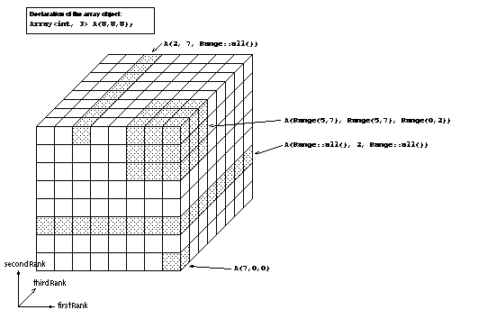
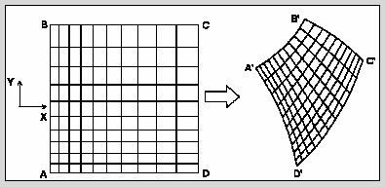
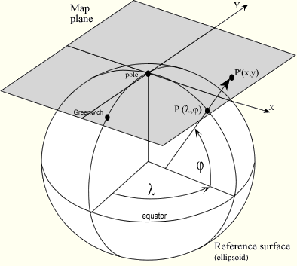
Gridded Data
Cartesian coordinates
Data is 2,3,4D
All dimensions have 1D coordinate variables (separable)
float gridData(t,z,y,x);
float t(t);
float y(y);
float x(x);
float z(z);
float lat(y,x);
float lon(y,x);
float height(t,z,y,x);

Slide 17
Supported Projections
albers_conical_equal_area
lambert_azimuthal_equal_area
lambert_conformal_conic
mcidas_area
mercator
orthographic
rotated_pole
stereographic (including polar)
transverse_mercator
UTM (ellipsoidal)
vertical_perspective

Slide 18

Web Map Service (WMS)
GetCapabilities -> metadata
GetMap -> map image, based on client-selected parameters, inc:
  Image width/height
  Image coordinate reference system
  Geographic bounding box
  Depth/height and time
  Style
GetFeatureInfo -> information about a particular map pixel
  Format not standardized
Specification supports 4D data (although tools often do not)

Slide 19
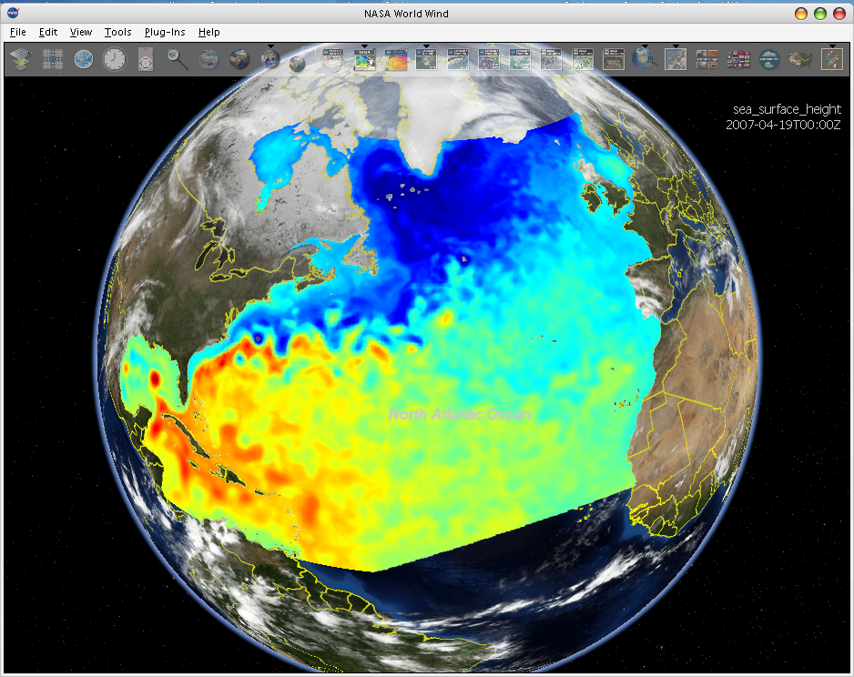
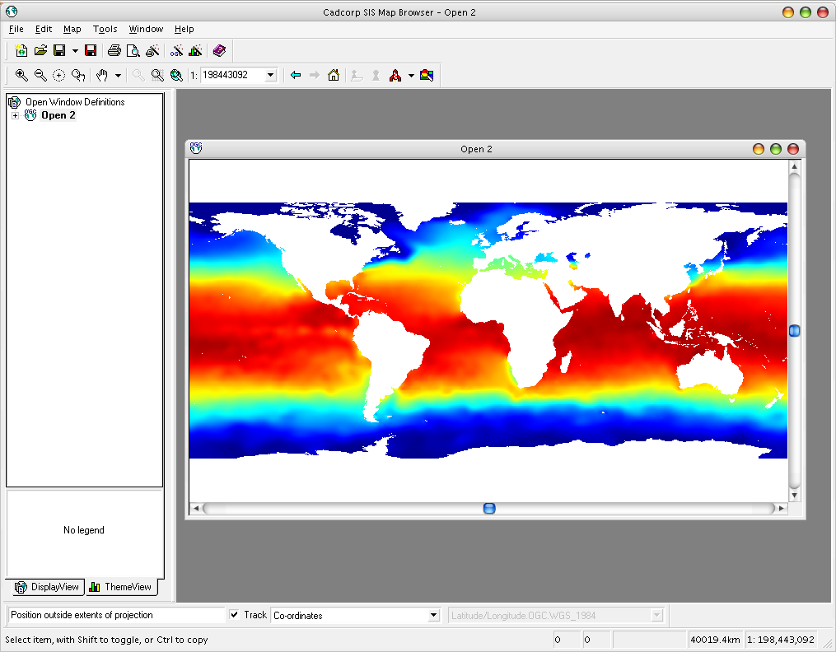
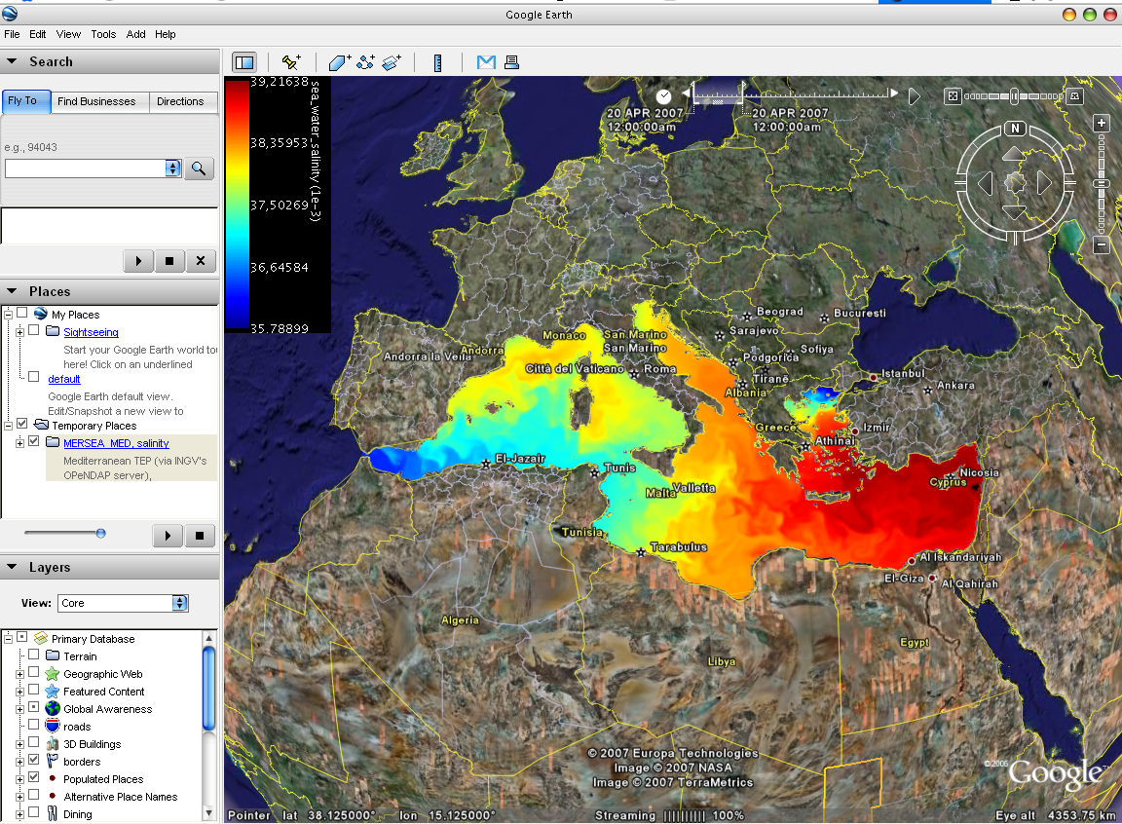
WMS Interoperability
NASA World Wind
Cadcorp SIS
Google Earth
3rd-party clients can’t use the custom WMS extensions

Slide 20
Notable features of ncWMS
Fast generation of images
Ability to read CDM datasets on variety of projections
Reproject images into large number of coordinate systems
  Uses geotools extensive projection library

Slide 21
Non-standard features
Piecemeal metadata-serving in JSON format
  avoids large XML Capabilities document
Extra metadata for science data
  e.g. units of measurement
New parameters in GetMap for styling:
  Choose colour palette
  Set contrast range
  Linear or logarithmic scaling
  Far simpler than Styled Layer Descriptor
Generation of timeseries plots via GetFeatureInfo
… but fully backward-compatible with WMS1.1.1 and 1.3.0

Slide 22
More Details
(presentations at GO-ESSP, Sep 2008)
WCS: Bruce Wright (UK met)
http://go-essp.gfdl.noaa.gov/2008/files/bruce_wright_GO-ESSP2008_WCSplus.ppt
WMS: Jon Blower (University of Reading (UK) E-Science Center)
http://go-essp.gfdl.noaa.gov/2008/files/THREDDS-WMS_Jon-Blower.ppt

Slide 23
Experimental Services
Mostly used just on motherlode
  not ready for general use
NetCDF Subset Service (ncss)
CDM Remote Service (cdmremote)
  Probably replace ncss
Radar Collection Service

Slide 24
NetCDF Subset Service
Experiment with REST style web service
Allow to subset the dataset by:
  Lat/lon bounding box
  time and vertical coordinate range
  list of Variables
Output: NetCDF, XML, CSV (spreadsheet)
Gridded Data
  Output is a CF / netCDF file
  Variation of WCS (simplified request protocol)
Grid as Point Datasets
  Extract vertical profile, time series from one point in model data
  Station Data: metars (7 day rolling archive)

Slide 25
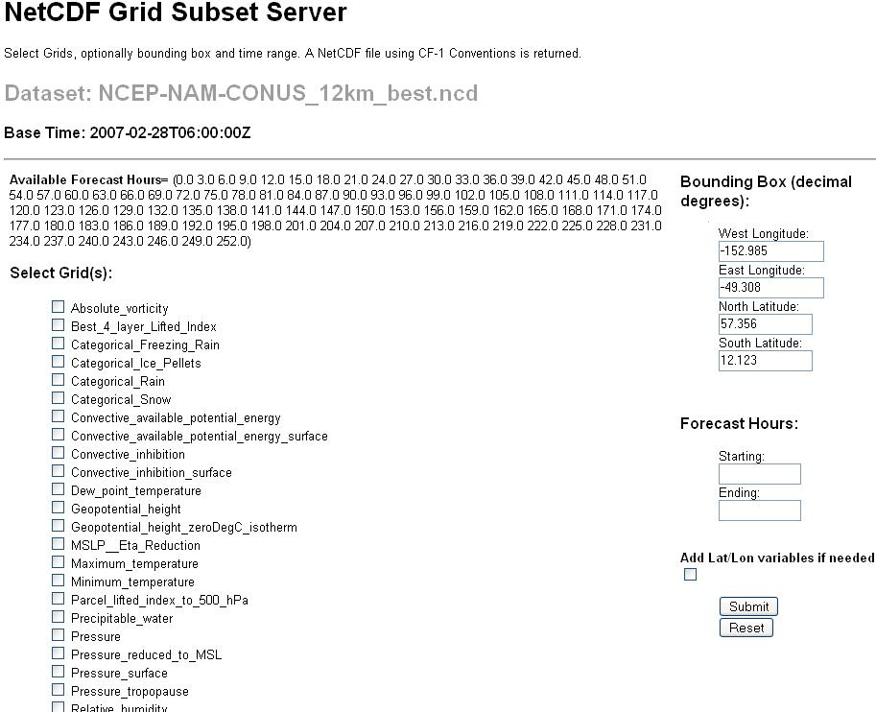

Slide 26
CDM Remote Service
Allow to subset the dataset by:
  Lat/lon bounding box
  time range
  list of Variables
NetCDF, XML, CSV (spreadsheet)
Point Feature Collections
  Large collections of files
  Point, Station, Profile, Trajectory, Section
  Proposed CF Conventions for Point Data
  Netcdf-Java Client APIs for access
Alpha release in 4.1 (Sept 2009)
Replace/extend NetCDF Subset Service

Slide 27
NEXRAD Radar level 2/3
Subset Service
Allow to subset the dataset by:
  Lat/lon bounding box
  time range
  list of Variables
Returns THREDDS catalog
  With OPeNDAP URLs
IDV uses this service

Slide 28
Other Services
“Latest Dataset” Service
  finds most recent dataset from a collection
CDM Coordinate System Validation
  Separate war file for security
Digital Library Record Exporting
  OAI protocol to GCMD

Slide 29
Using TDS in other ways
Use TDS as a back end
  Live Access Server (LAS)
  Ramadda
  NCAR CDP
Serve remote data
  Can read OPeNDAP from other servers
  Modify with NcML
  Serve out as WCS etc

Slide 30
Ferret-THREDDS Data Server (F-TDS)
New "virtual" data variables can be defined
Can build the metadata without performing any heavy calculations for both data read from files and “virtual” data variables
Only performs calculations when the data are requested
Only calculates the minimal set needed to fulfill the current request
Allows URL-based server-side analysis requests
Installs easily in an existing TDS
Notes:
A URL-base server-side analysis request can include references to external data sources which can be used in defining new variables.

Slide 31
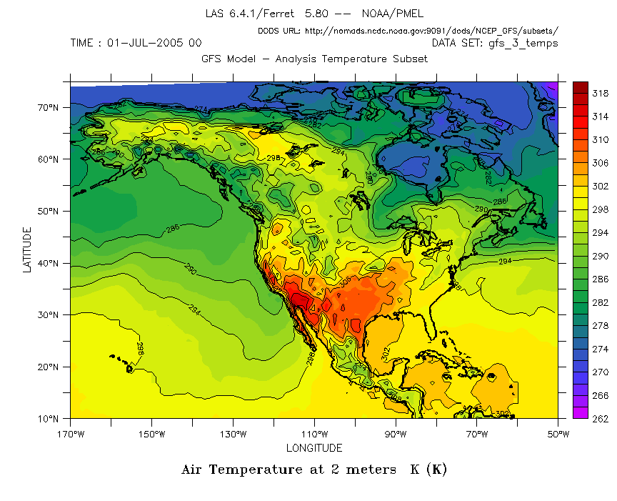

Slide 32
TDS backend
HTTP Tomcat Server
Remote Access
Web Portal
TDS
CDM
Visualization
Another
Data Server
Datasets

Slide 33
TDS remote service
HTTP Tomcat Server
Remote Access
TDS
WCS
CDM
Another
Data Server
OPeNDAP

Slide 34



